Slide 1
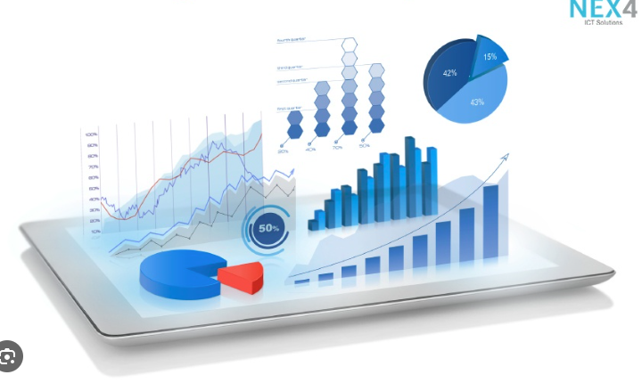
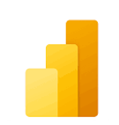



Data Visualization
in Power BI
03 Advanced Visuals
Prepared By :
Said Fawzy
Manager of Information Center
Tendering Department
Arab Contractors

Slide 2

1
Combo Chart
2
Matrix
3
Treemaps
4
Funnel Chart

Slide 3
5
Ribbon Chart
6
Waterfall Chart
7
Scatter Chart
8
Cards

Slide 4
1
Combo Chart

Slide 5
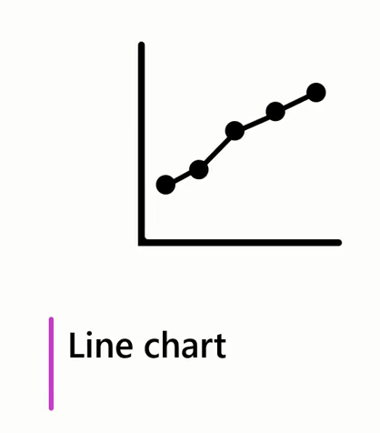
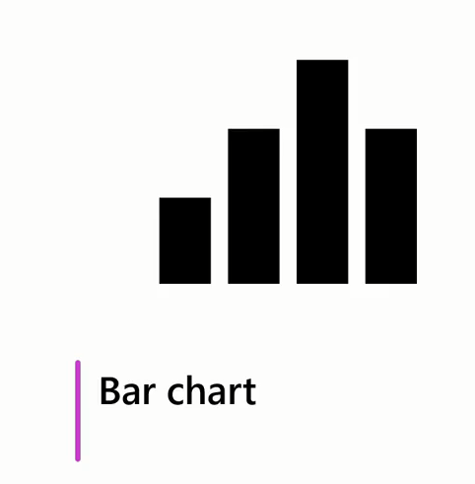
Combo Chart
Sales in Regions Through months
Quantity Sold

Slide 6
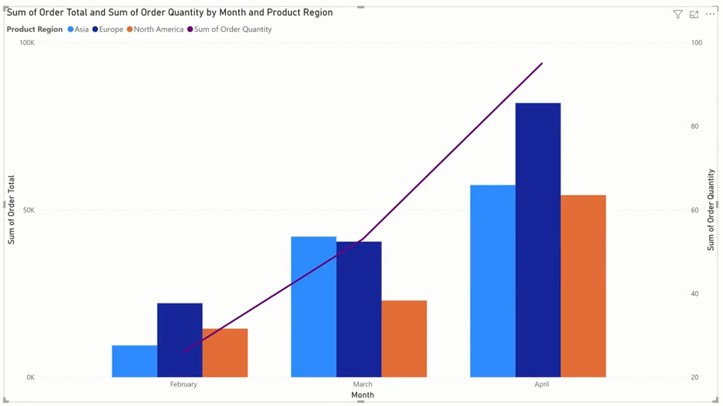
Combo Chart

Slide 7
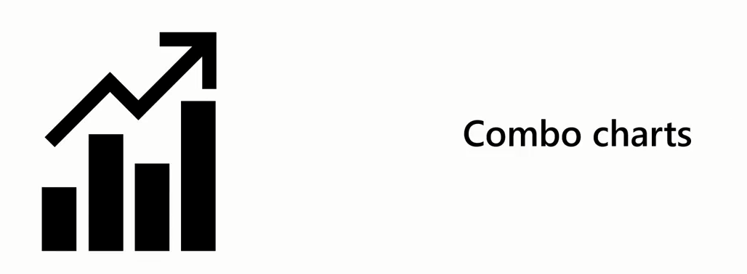
Combo Chart
A combo chart is a dynamic combination of a line and a column chart, allowing you to visually represent two different, yet interconnected data points.

Slide 8
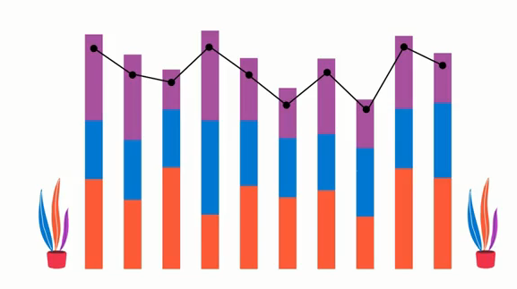
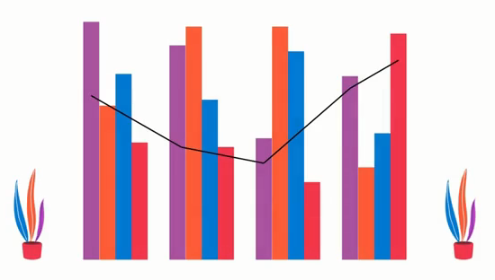
Type of Combo Chart
A line and a stacked column chart
A line and a clustered column chart

Slide 9
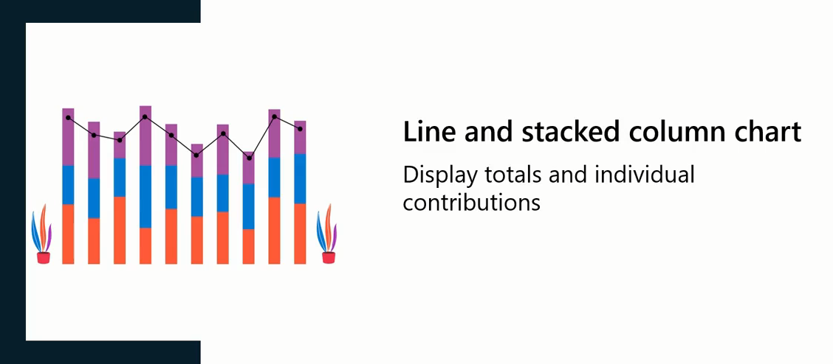
Line and Stacked Column Chart

Slide 10
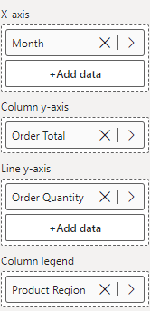
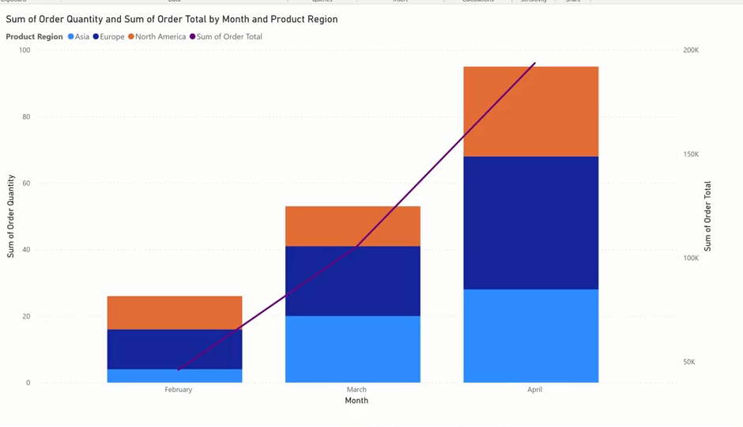
Line and Stacked Column Chart
How to Create

Slide 11
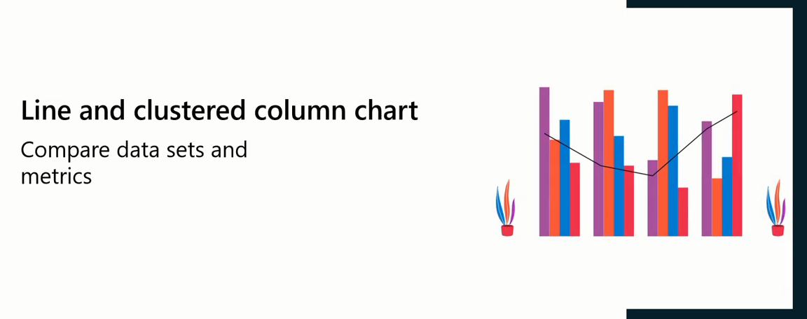
Line and Clustered Column Chart

Slide 12
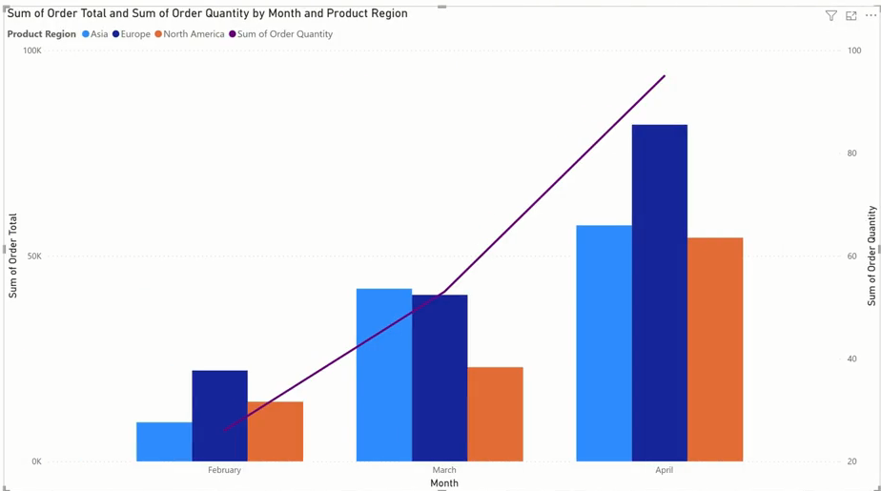
Line and Clustered Column Chart
Example

Slide 13
Line and Clustered Column Chart
How to Create

Slide 14

Exercise 11:
Combo Chart

Slide 15
Question
In Microsoft Power BI, which combo chart is most suitable for comparing multiple sets of data side by side?
A. Line and clustered column chart
B. Area chart
C. Bar chart
D. Line and stacked column chart

Slide 16
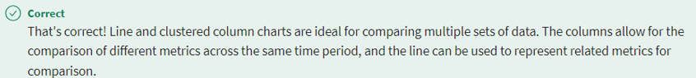
ANSWER
In Microsoft Power BI, which combo chart is most suitable for comparing multiple sets of data side by side?
A. Line and clustered column chart
B. Area chart
C. Bar chart
D. Line and stacked column chart

Slide 17
2
Matrix

Slide 18
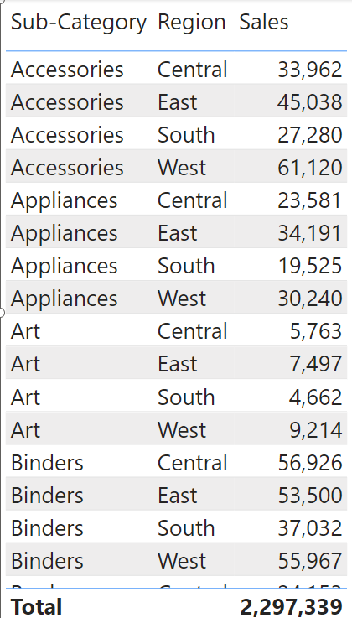
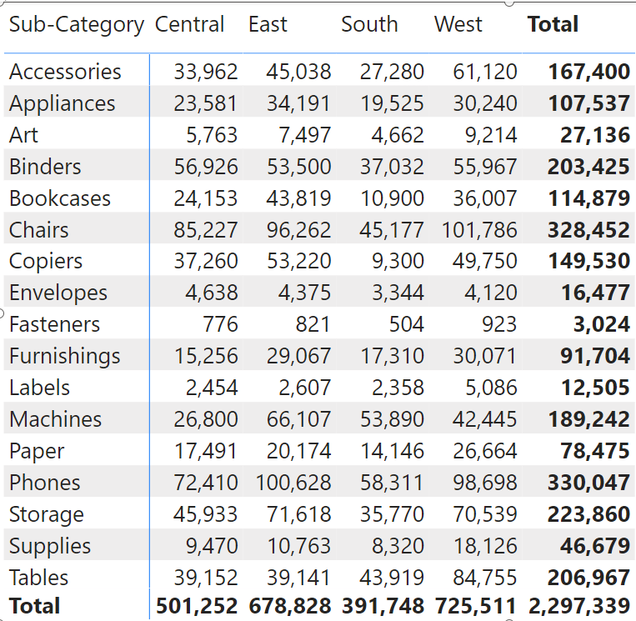
Matrix
The matrix visual is similar to a table but has key features that allow the report designer to communicate multiple levels of information in the data.

Slide 19
Matrix
A table supports two dimensions, and the data is flat, meaning duplicate values are displayed and not aggregated. On the other hand, a matrix makes it easier to display data meaningfully across multiple dimensions because it supports a stepped layout.

Slide 20
Matrix
Unlike the table, the matrix automatically aggregates the data, enabling the viewer to drill down into the detail.

Slide 21
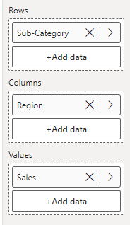
Matrix

Slide 22
Exercise 12:
Create Matrix

Slide 23
3
Treemaps

Slide 24
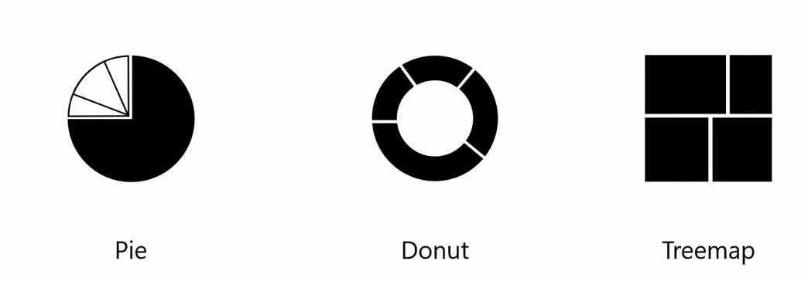
Treemap
Treemaps are another helpful tool for illustrating your proportional data

Slide 25

Treemap
Instead of circles, treemaps use rectangles to display your data, making the best use of space in your reports and add variety by displaying data in new and exciting ways

Slide 26
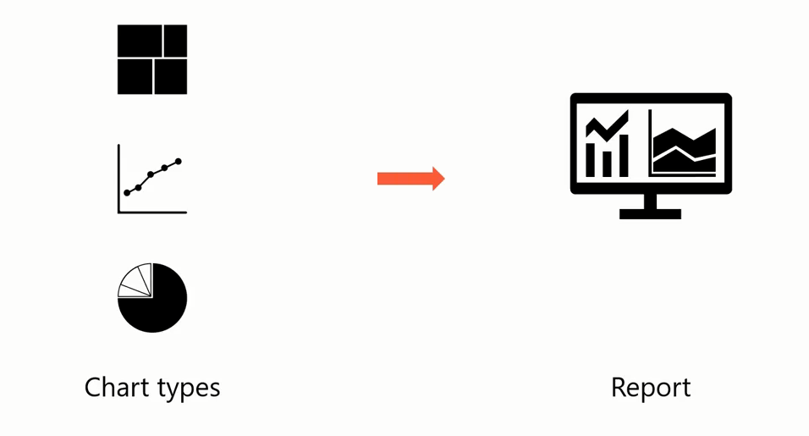
Treemap
Add Variety.
Make full use of report space.

Slide 27

Treemap
Treemap is a visual used to display hierarchical data or data that's organized in a tree like structure as nested rectangles

Slide 28


Treemap
The entire chart represents the total dataset or tree.
Each rectangle or branch represents a portion of the whole tree

Slide 29
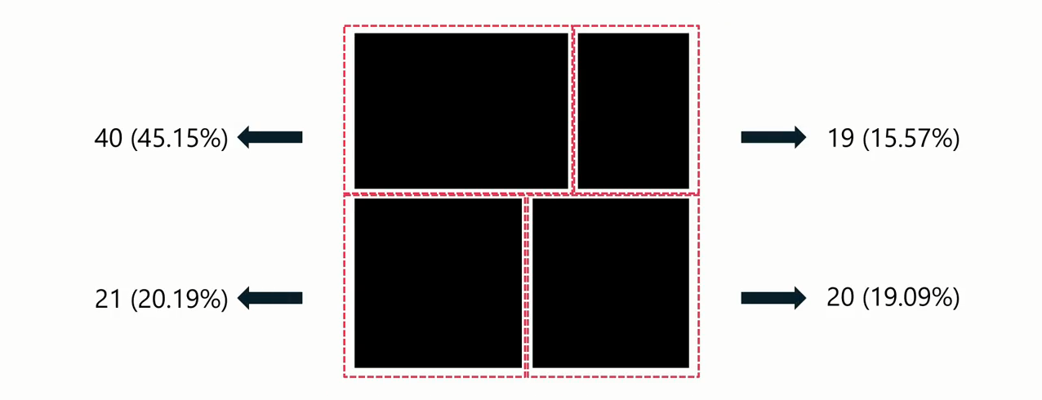
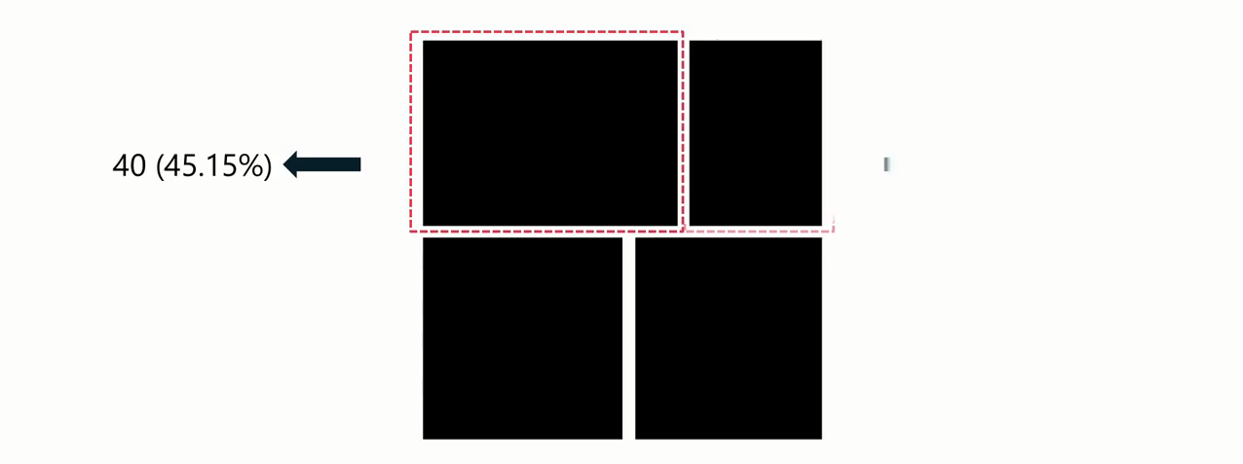
Treemap
Each rectangle size corresponds to the value or size of the data it represents

Slide 30
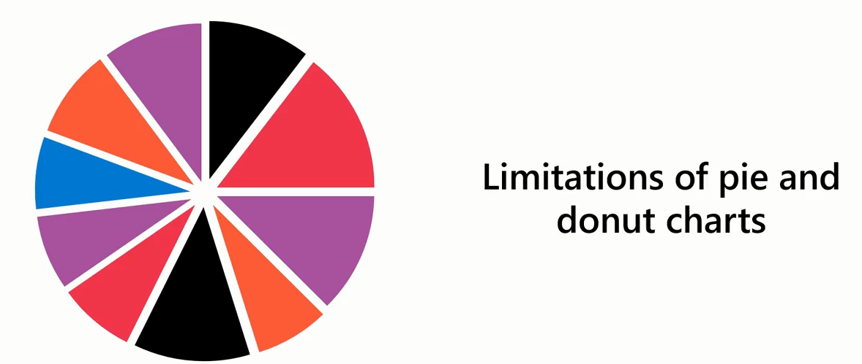
Treemap
Pie and donut charts can become cluttered and difficult to read when dealing with:
Many categories of variables, or
When the differences between data points are small.

Slide 31
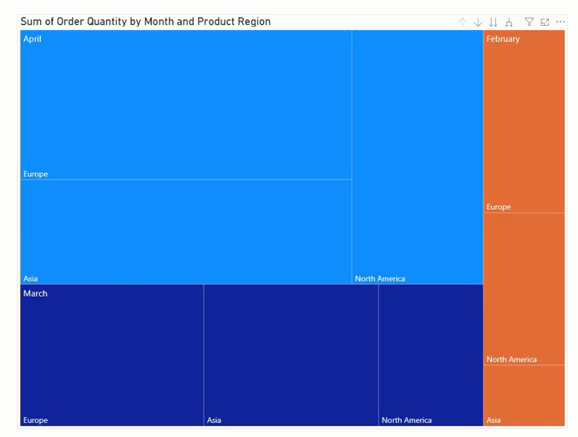
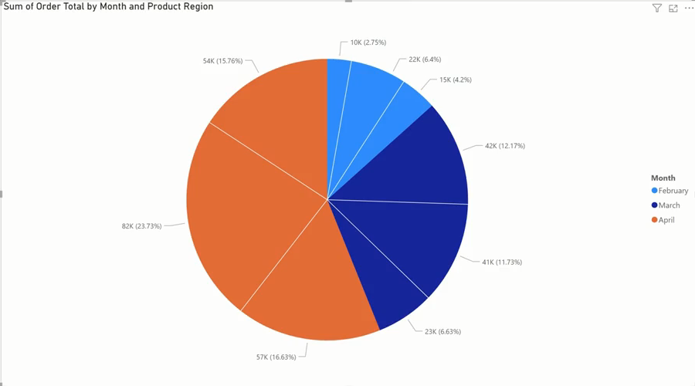
Treemap
Example

Slide 32
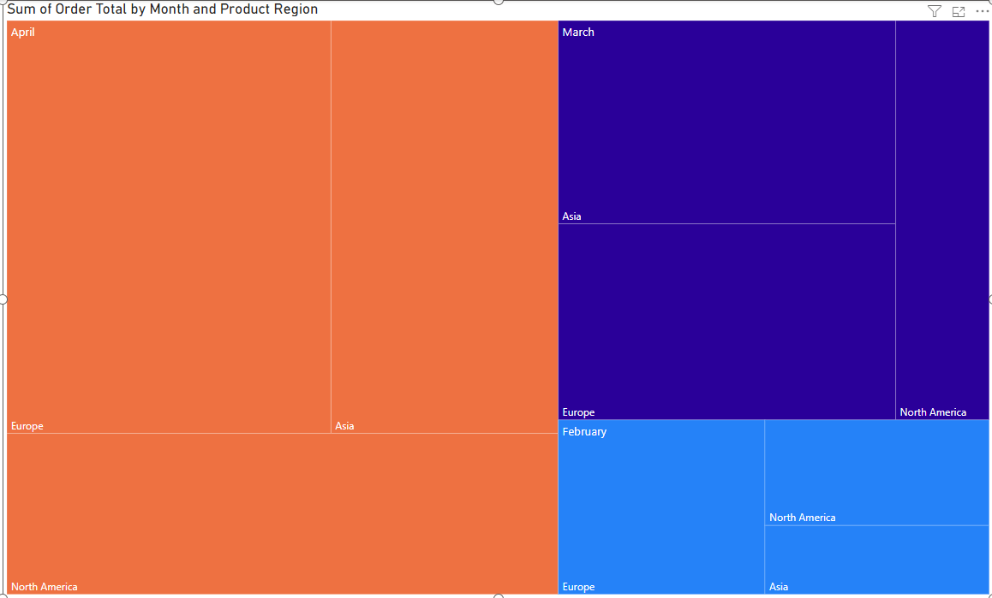
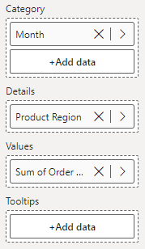
Treemap

Slide 33
Exercise 13:
Create Treemap

Slide 34
Question
In Microsoft Power BI, what is the primary purpose of a treemap chart?
A. A treemap chart is used to display hierarchical data.
B. A treemap is used to compare multiple data series and identify trends.
C. A treemap chart is used to visualize changes in data over time.
D. A treemap chart is used to represent small datasets.

Slide 35
ANSWER
In Microsoft Power BI, what is the primary purpose of a treemap chart?
A. A treemap chart is used to display hierarchical data.
B. A treemap is used to compare multiple data series and identify trends.
C. A treemap chart is used to visualize changes in data over time.
D. A treemap chart is used to represent small datasets.

Slide 36
4
Funnel Chart

Slide 37
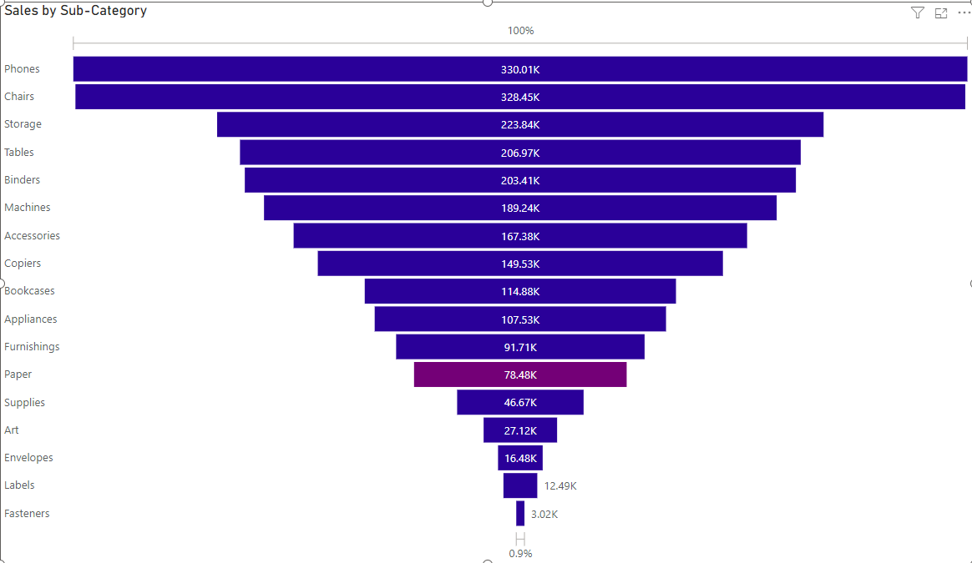
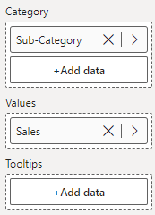
Funnel Chart

Slide 38
Exercise 14:
Create Simple Funnel Chart

Slide 39

Funnel Chart

Slide 40

Funnel Chart

Slide 41

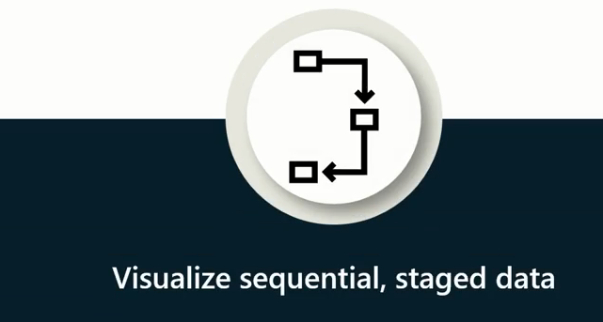
Funnel Chart

Slide 42



Funnel Chart
Expected Greater
Decline

Slide 43
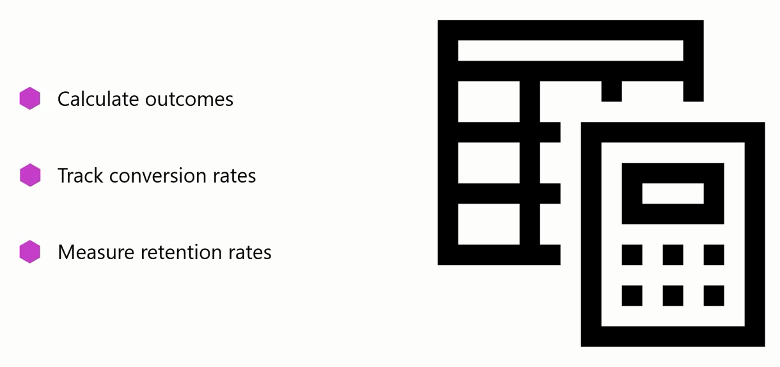
Funnel Chart

Slide 44
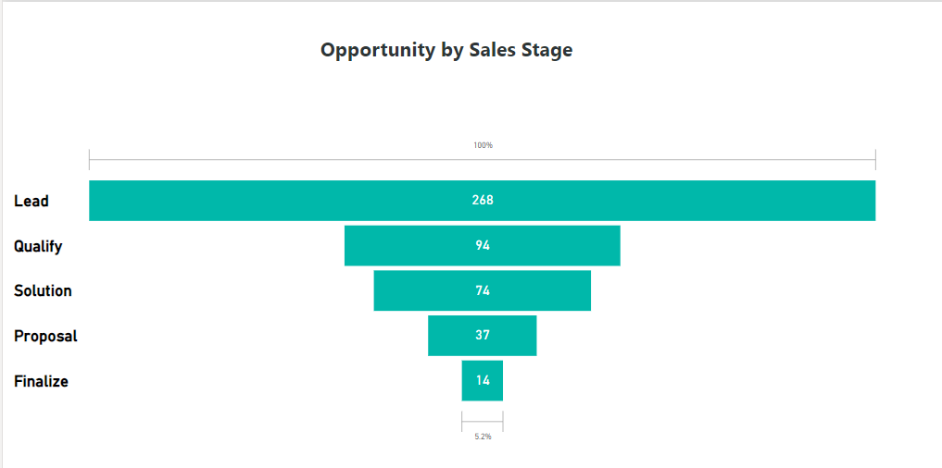
Funnel Chart
Customer is interested
Customer is evaluated
Tailored solution for customer
Formal Proposal sent
Agree and Close the deal
Example

Slide 45
Exercise 15:
Create Sales Funnel Chart

Slide 46
Question
In Microsoft Power BI, which field in a funnel chart is used to define the different stages of a process?
A. Legend
B. Values
C. Category
D. Tooltips

Slide 47
ANSWER
In Microsoft Power BI, which field in a funnel chart is used to define the different stages of a process?
A. Legend
B. Values
C. Category
D. Tooltips

Slide 48
5
Ribbon Chart

Slide 49
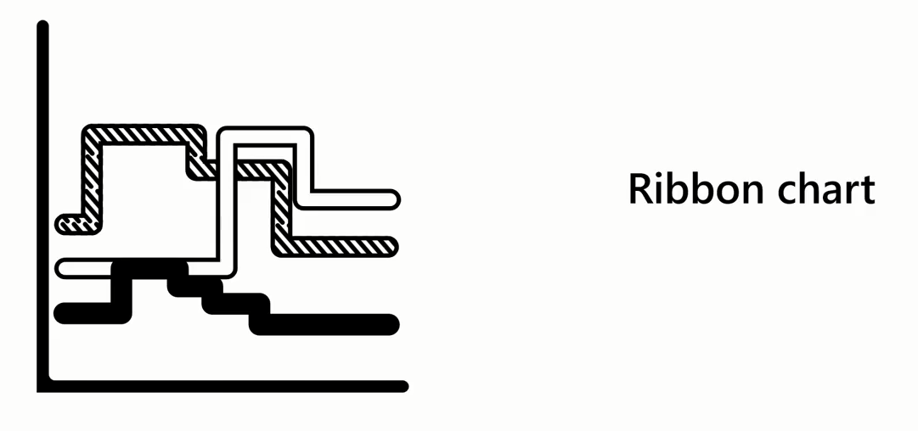
Ribbon Chart
A ribbon chart is a form of stacked chart for visualizing data and changes over time and has a clear ranking order.

Slide 50
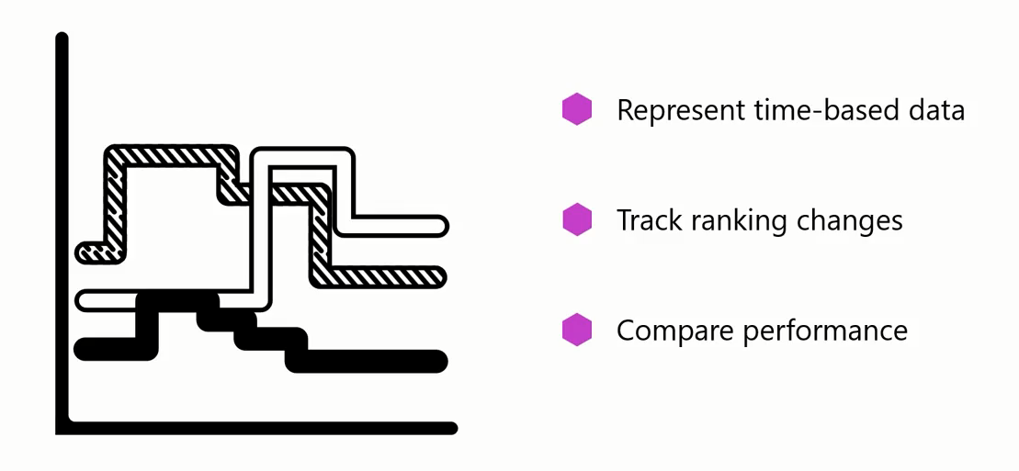
Ribbon Chart

Slide 51
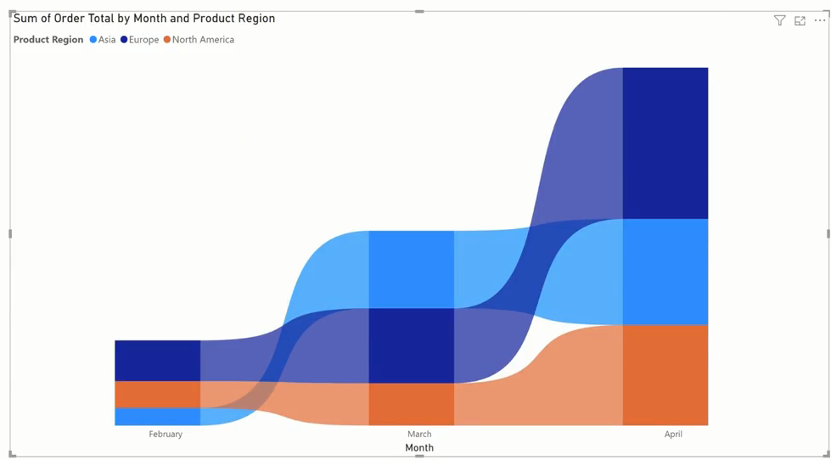
Ribbon Chart

Slide 52
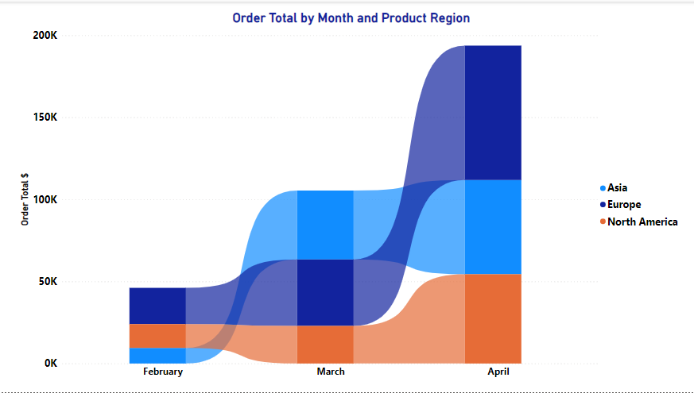
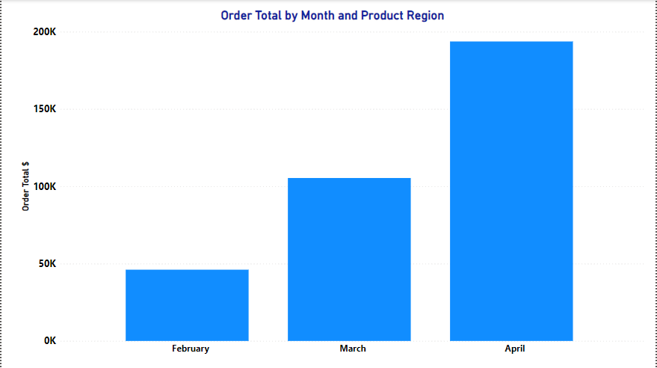
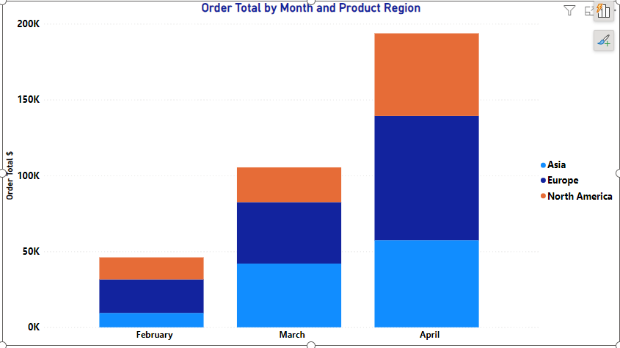



Ribbon Chart

Slide 53
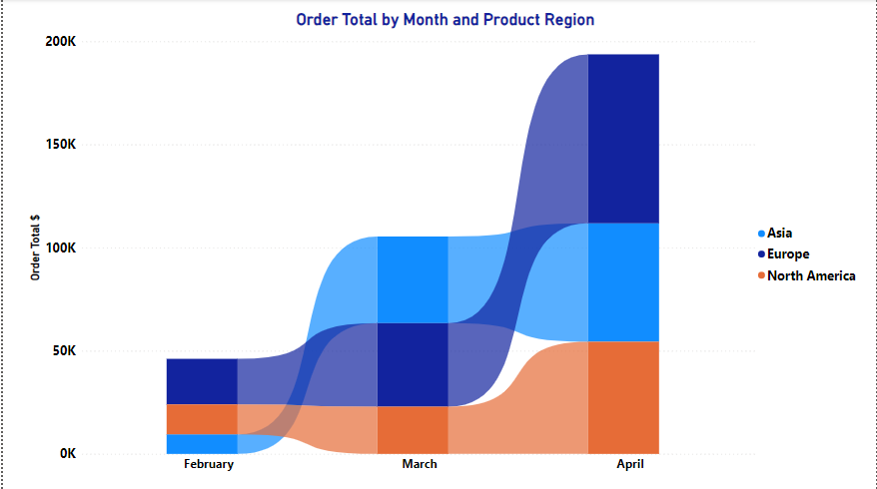
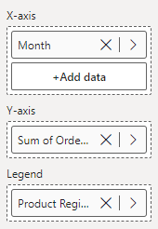
Ribbon Chart

Slide 54
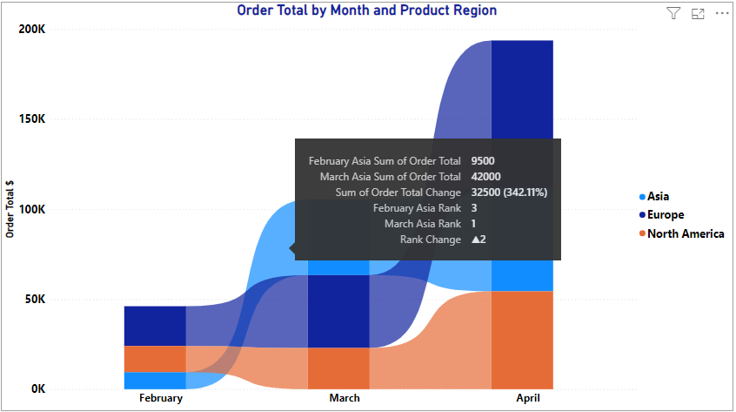
Ribbon Chart

Slide 55
Exercise 16:
Create Ribbon Chart

Slide 56
6
Waterfall Chart

Slide 57
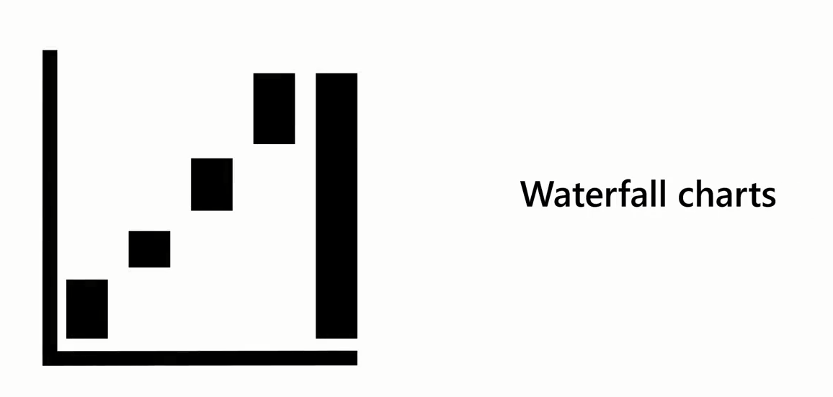
Waterfall Chart
Waterfall charts show a running total as Power BI adds and subtracts values.

Slide 58

Waterfall Chart
In data analysis and visualization, cumulative effects refer to how an initial value is affected by a series of positive or negative sequential factors, events, or changes over time.

Slide 59
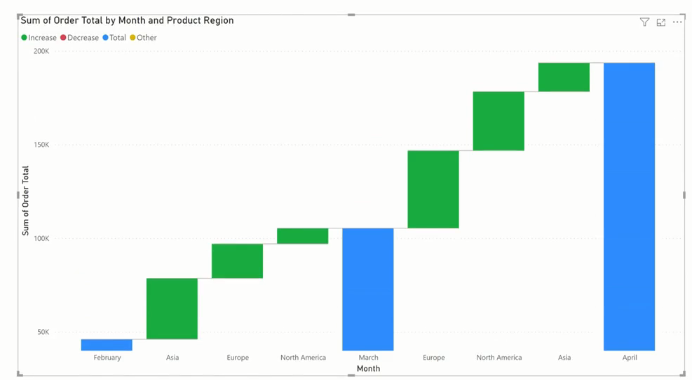
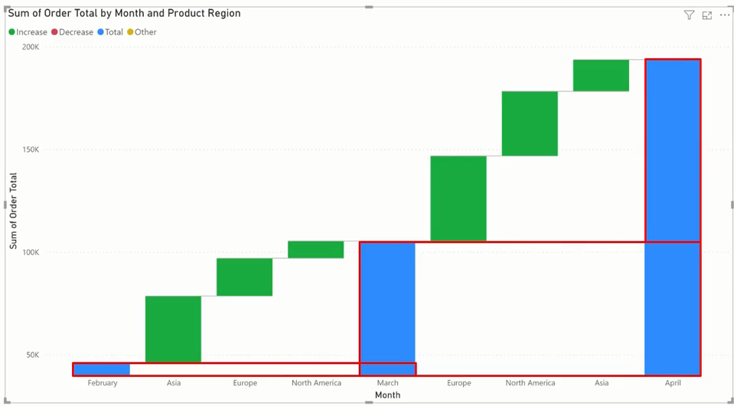
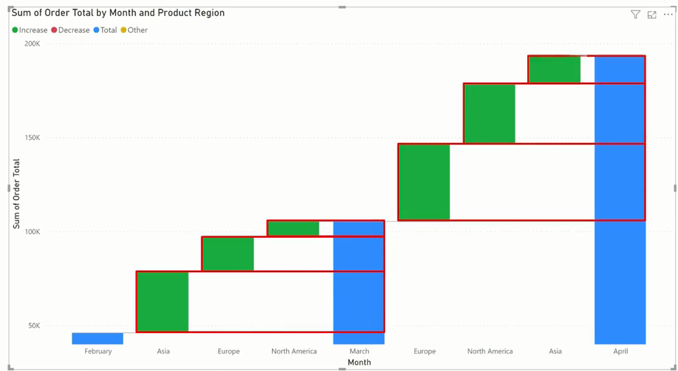
Waterfall Chart
Example

Slide 60
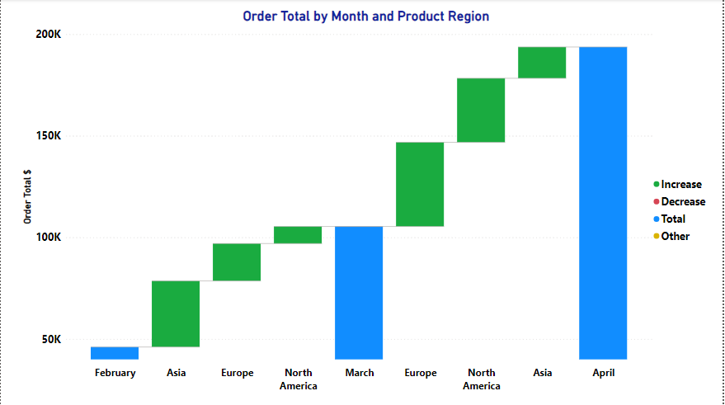
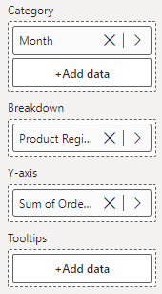
Waterfall Chart

Slide 61
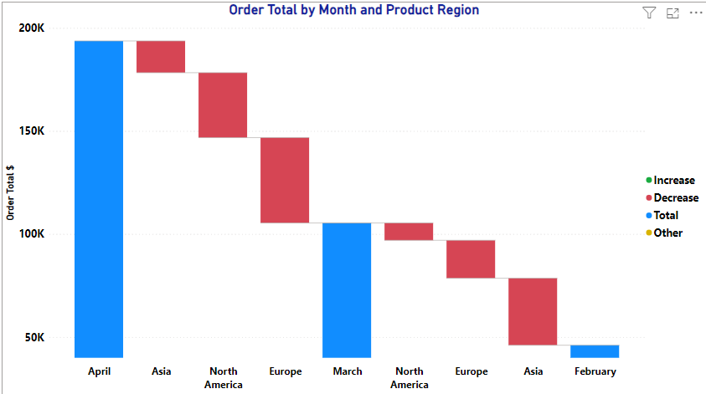
Waterfall Chart

Slide 62
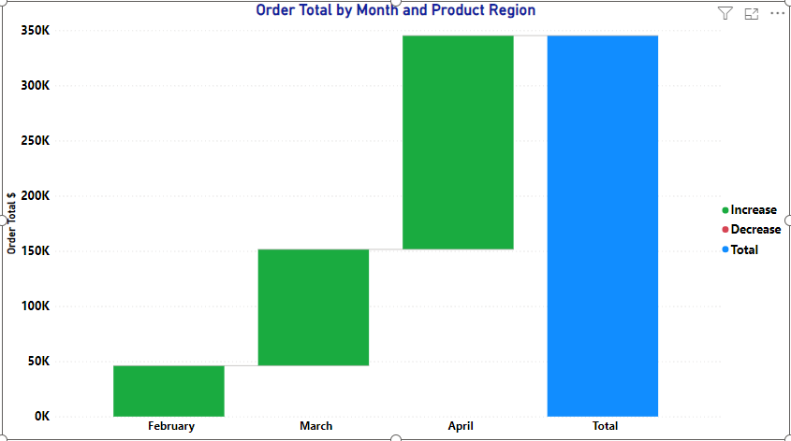
Waterfall Chart
Unlike ribbon charts, Break Down field is optional in waterfall charts.

Slide 63
Exercise 17:
Create Waterfall Chart

Slide 64
Question
Which of the following scenarios is best suited to using a waterfall chart in Microsoft Power BI?
A. To compare numerical data points across different categories
B. To track a single metric over time and identify trends
C. To track the changes in sales ranking of different product categories over time
D. To analyze the cumulative impact of financial factors on net income

Slide 65
ANSWER
Which of the following scenarios is best suited to using a waterfall chart in Microsoft Power BI?
A. To compare numerical data points across different categories
B. To track a single metric over time and identify trends
C. To track the changes in sales ranking of different product categories over time
D. To analyze the cumulative impact of financial factors on net income

Slide 66
7
Scatter Chart

Slide 67
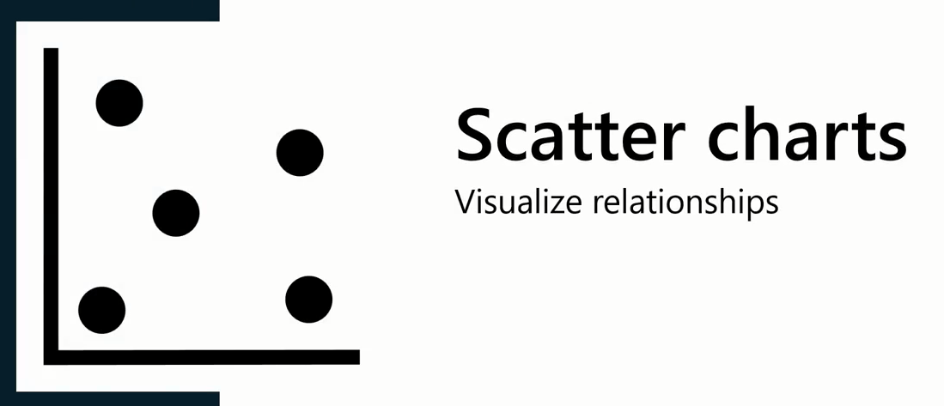
Scatter Chart

Slide 68
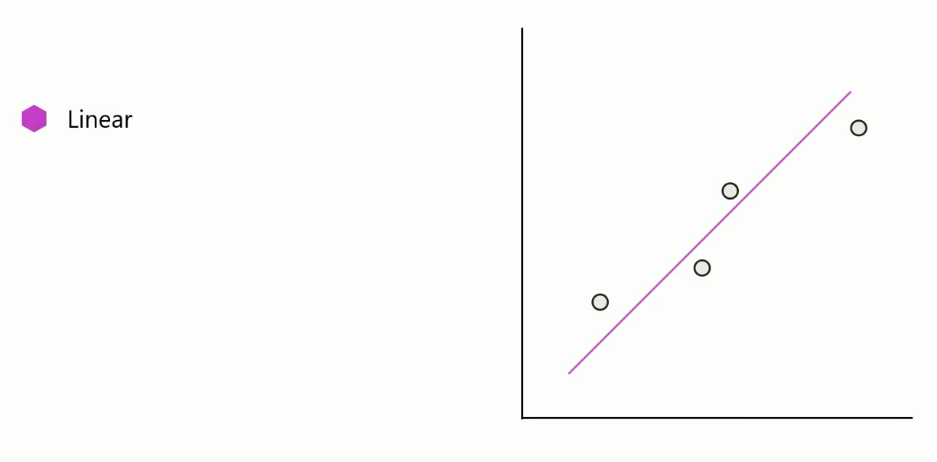
Scatter Chart

Slide 69


Scatter Chart

Slide 70


Scatter Chart

Slide 71







Scatter Chart

Slide 72
Scatter Chart
Scatter charts can help you identify:
trends,
patterns, and
anomalies like outliers in your data.

Slide 73
Scatter Chart
Anomalies refer to deviations from the general pattern of the data.

Slide 74

Scatter Chart
Outliers are a type of anomaly where valid data points significantly differ from other observations deviating from the general data trend.

Slide 75

Scatter Chart
Example
Revenue
Marketing Spent

Slide 76

Scatter Chart
Example
In this example, each dot shows one person's weight versus their height.

Slide 77

Scatter Chart
Example: An ice cream shop keeps track of each day's noon temperature and how much ice cream they sell that day. Here are data for 12 days:

Slide 78

Scatter Chart

Slide 79

Scatter Chart , Bubble and Dot ploy

Slide 80

Scatter Chart , Bubble and Dot ploy
To display the relationship between two numeric variables, you can create a scatter plot that defines the correlation between variables.

Slide 81

Scatter Chart , Bubble and Dot ploy
A variation of a scatter plot is a bubble chart that can display the relationship between three variables.
The third variable is represented in the size of a bubble.

Slide 82

Scatter Chart , Bubble and Dot ploy

Slide 83

Scatter Chart , Bubble and Dot ploy
Dot plot is one such visualization that is popular when presenting categorical data in relation to a numerical value.

Slide 84

Scatter Chart , Bubble and Dot ploy

Slide 85

Scatter Chart , Bubble and Dot ploy
Your Company needs insights into regional product category sales performance.
They need to know:
the quantity sold for each category and
the revenue per country.
Example

Slide 86

Scatter Chart , Bubble and Dot ploy

Slide 87
Exercise 18:
Create Scatter Chart

Slide 88


World Happiness Report
https://en.wikipedia.org/wiki/World_Happiness_Report

Slide 89
Question 1
In a scatter chart, what term describes a data point that significantly deviates from the other data points?
A. Axis
B. Outlier
C. Legend
D. Cluster

Slide 90

ANSWER
In a scatter chart, what term describes a data point that significantly deviates from the other data points?
A. Axis
B. Outlier
C. Legend
D. Cluster

Slide 91
Question 2
Which statements are true about dot plot chart? Select all that apply.
A. Dot plot chart is a variation of a scatter plot in Power BI.
B. Dot plot chart allows you to display relationship between two numerical data values.
C. Dot plot chart can be directly created from the visualization pane of Power BI desktop.
D. Dot plot chart enables you to plot categorical data on the horizontal axis of the chart.

Slide 92
ANSWER 2
Which statements are true about dot plot chart? Select all that apply.
A. Dot plot chart is a variation of a scatter plot in Power BI.
B. Dot plot chart allows you to display relationship between two numerical data values.
C. Dot plot chart can be directly created from the visualization pane of Power BI desktop.
D. Dot plot chart enables you to plot categorical data on the horizontal axis of the chart.

Slide 93
8
Cards

Slide 94

Cards

Slide 95

Card Visual

Slide 96

Card Visual

Slide 97

Multi-row Card Visual

Slide 98

Radial gauge Visual
They take up a lot of space compared to the insights they provide.

Slide 99




Radial gauge Visual

Slide 100

KPI Visual

Slide 101
Exercise 19:
Create Card Visual Charts

Slide 102
Question
In Microsoft Power BI, which visualization tool allows you to track a measure's performance against a target and how the data changes over time?
A. Multi-row card
B. Gauge
C. KPI visual
D. Card

Slide 103
ANSWER
In Microsoft Power BI, which visualization tool allows you to track a measure's performance against a target and how the data changes over time?
A. Multi-row card
B. Gauge
C. KPI visual
D. Card

Slide 104


Slide 105
Question 1
In Microsoft Power BI, which of the following statements is true about using the report area space more effectively?
A. Both treemap and pie charts use the same amount of space to display the same data.
B. Pie charts are more space-efficient than treemap charts.
C. The space efficiency of a chart type does not impact the readability of the data.
D. Treemap charts make more efficient use of space than pie charts.

Slide 106
ANSWER 1
In Microsoft Power BI, which of the following statements is true about using the report area space more effectively?
A. Both treemap and pie charts use the same amount of space to display the same data.
B. Pie charts are more space-efficient than treemap charts.
C. The space efficiency of a chart type does not impact the readability of the data.
D. Treemap charts make more efficient use of space than pie charts.

Slide 107
Question 2
You are analyzing data for a multi-department company and want to show how each department's monthly expenses contribute to the total expenses over a year. Which chart type would be the most suitable choice in this scenario?
A. Stacked area chart
B. Pie chart
C. Donut chart
D. Line chart

Slide 108

ANSWER 2
You are analyzing data for a multi-department company and want to show how each department's monthly expenses contribute to the total expenses over a year. Which chart type would be the most suitable choice in this scenario?
A. Stacked area chart
B. Pie chart
C. Donut chart
D. Line chart

Slide 109
Question 3
You've been tracking the monthly sales and advertising spending of a company's product line over the past two years. You want to show the correlation between advertising spending and sales and the trend of sales from different product categories. Which chart type would be the most suitable choice in this scenario?
A. Area chart
B. Bar chart
C. Line and stacked column chart
D. Line chart

Slide 110

ANSWER 3
You've been tracking the monthly sales and advertising spending of a company's product line over the past two years. You want to show the correlation between advertising spending and sales and the trend of sales from different product categories. Which chart type would be the most suitable choice in this scenario?
A. Area chart
B. Bar chart
C. Line and stacked column chart
D. Line chart

Slide 111
Question 4
Which of the following statements are true about funnel charts? Select all that apply.
A. Funnel charts are ideal for illustrating data that follows a sequential order through multiple stages.
B. Funnel charts must be used only when the data volume increases from the initial to the final stage.
C. Funnel charts are ideal for calculating and tracking conversion and retention rates.
D. Funnel charts are helpful in identifying bottlenecks in a process.

Slide 112
ANSWER 4
Which of the following statements are true about funnel charts? Select all that apply.
A. Funnel charts are ideal for illustrating data that follows a sequential order through multiple stages.
B. Funnel charts must be used only when the data volume increases from the initial to the final stage.
C. Funnel charts are ideal for calculating and tracking conversion and retention rates.
D. Funnel charts are helpful in identifying bottlenecks in a process.

Slide 113
Question 5
The regional sales team of a large retail corporation wants to evaluate their performance over the last year. They've collected data including the average customer satisfaction score, total sales, and the number of customer complaints received per month for each store in the region. Which type of visualization would be most suitable for analyzing the relationship between average customer satisfaction score and total sales, while also considering the number of customer complaints per store?
A. Line chart
B. Bar chart
C.Scatter chart
D.Pie chart

Slide 114

ANSWER 5
The regional sales team of a large retail corporation wants to evaluate their performance over the last year. They've collected data including the average customer satisfaction score, total sales, and the number of customer complaints received per month for each store in the region. Which type of visualization would be most suitable for analyzing the relationship between average customer satisfaction score and total sales, while also considering the number of customer complaints per store?
A. Line chart
B. Bar chart
C.Scatter chart
D.Pie chart

Slide 115


